Slide 1

Heal-API Form Tutorial Presentation
Fill the Form Correctly — Get a Working cURL Instantly
Understand each field before sending your API request.

Slide 2
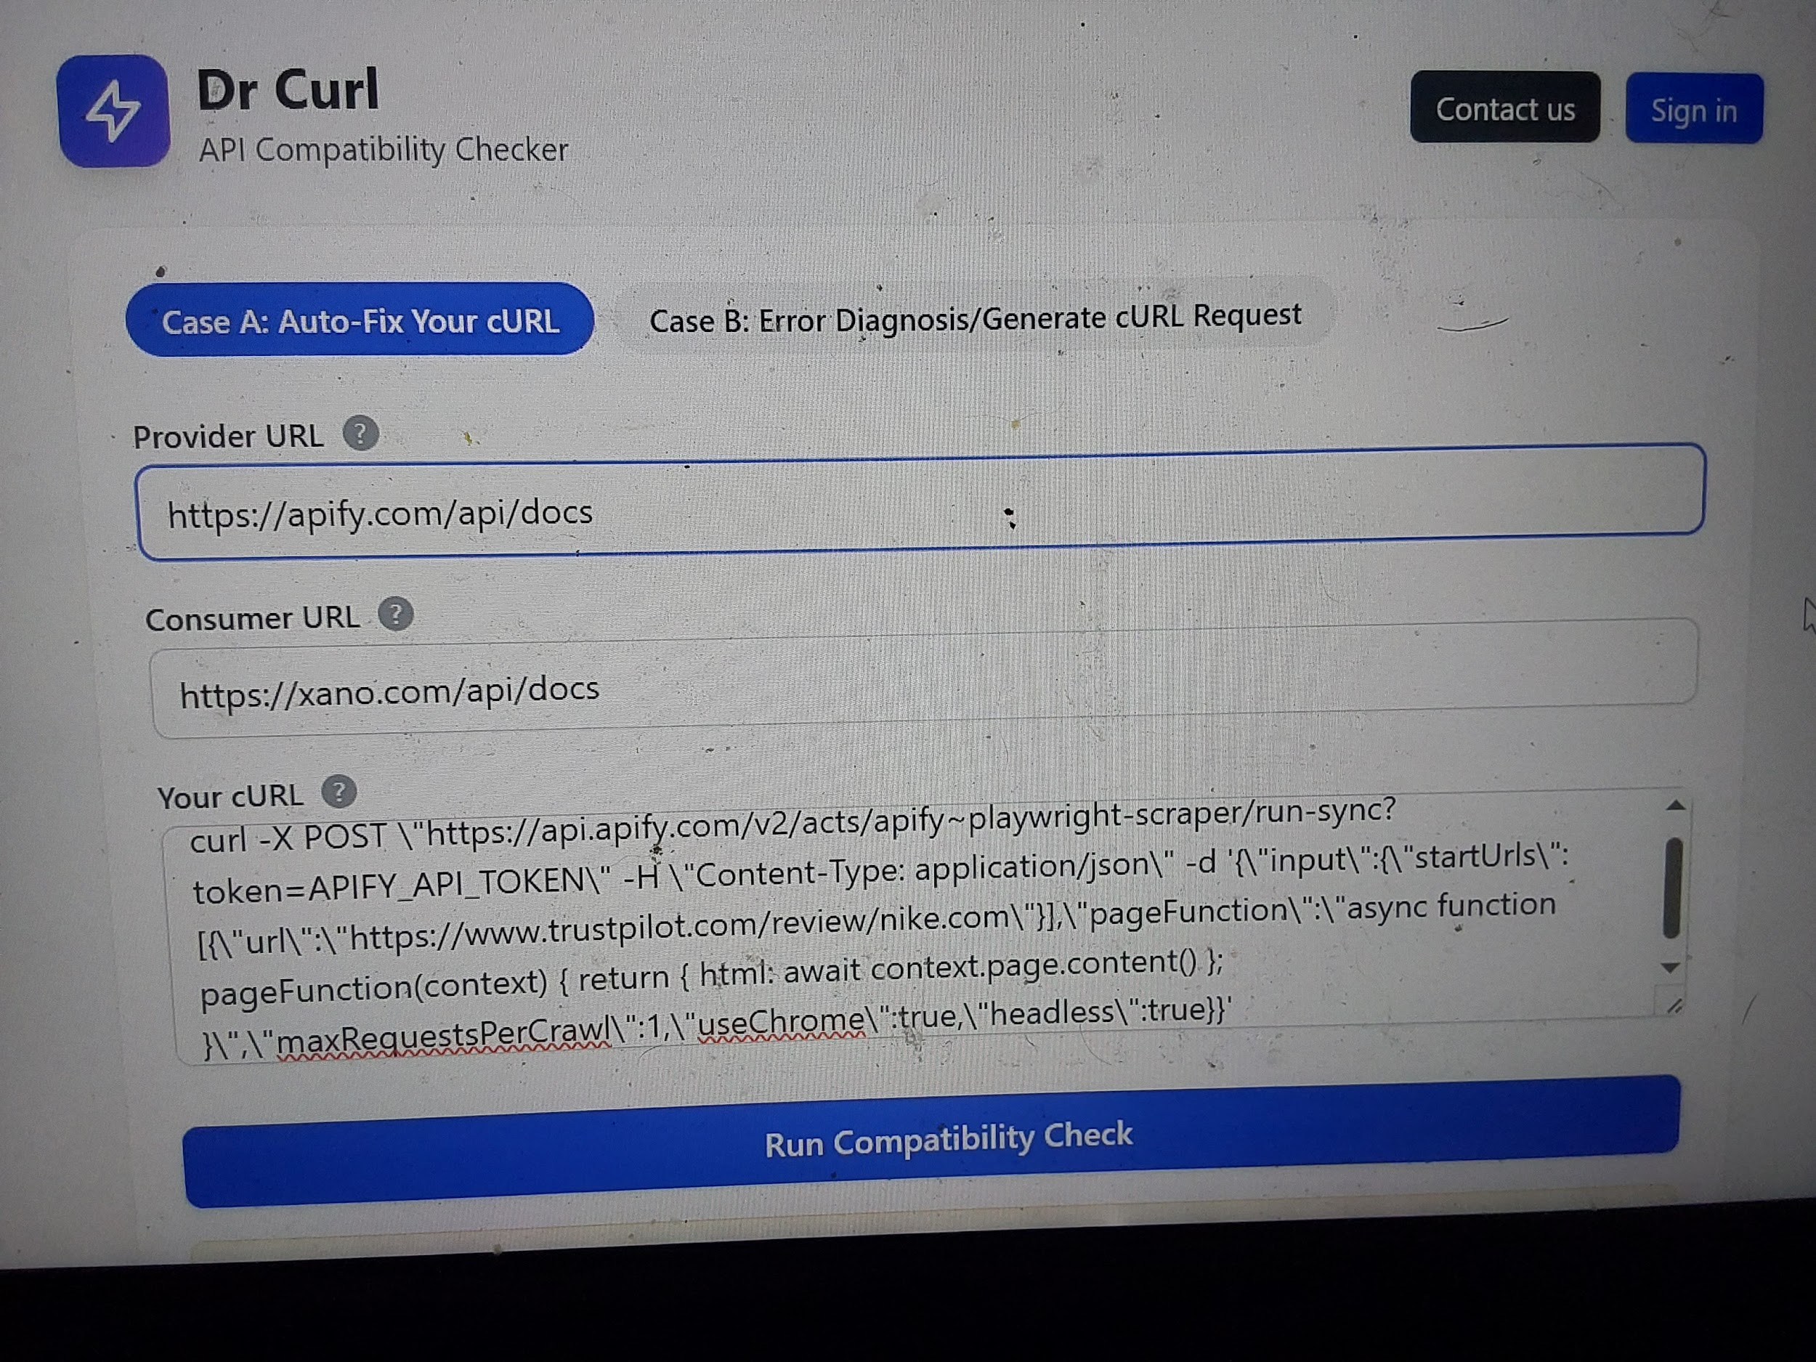

Slide 3
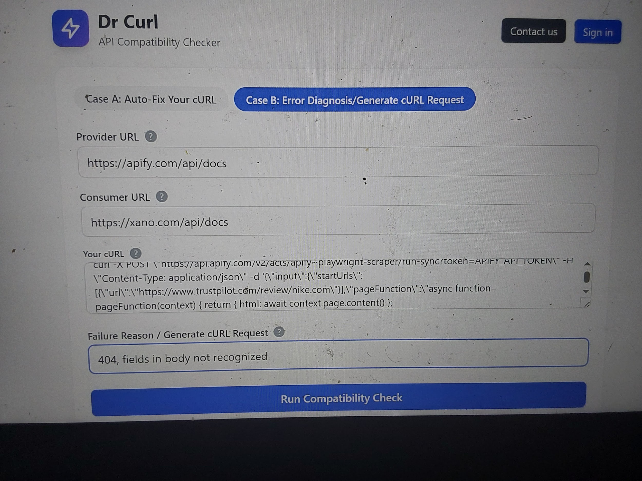

Slide 4
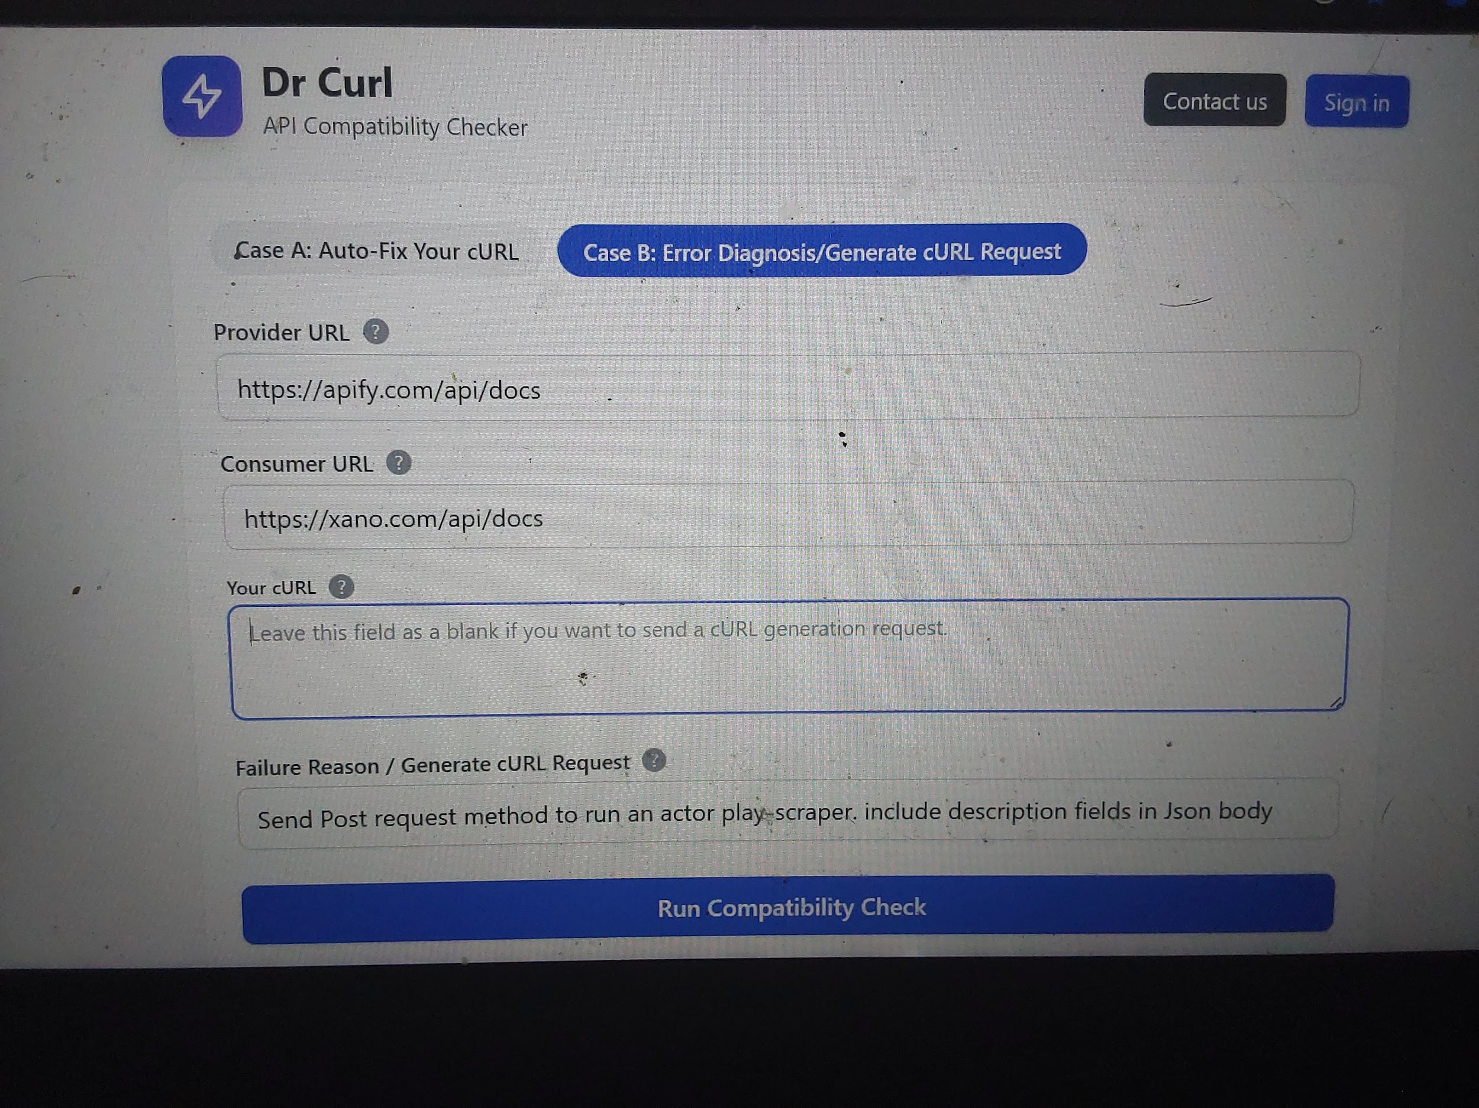

Slide 5




Field Overview
Example
Description
Field
https://api.openai.com/v1/chat/completions
The external API endpoint you are connecting to. This is usually from a service like PayPal, OpenAI, or Xano.
Provider URL
https://heal-api.com/webhook/response
Your API endpoint or app that consumes data. Often a webhook or backend endpoint.
Consumer URL
GET, POST, PATCH, DELETE
Defines what action the request performs.
Method
Authorization: BearerContent-Type: application/json
Key-value pairs to provide authentication and content information.
Headers
{ "userId": 123, "status": "active" }
The content or parameters sent with your request.
Body (JSON)
URL Fields
Method
Provider and Consumer endpoints
Request action type
Headers
JSON Body
Authentication and metadata
Request payload content

Slide 6


Common Mistakes
🚫 Missing https:// prefix in URLs
🚫 Wrong Method (e.g., using POST instead of GET)
🚫 Forgetting Authorization header
🚫 Sending invalid JSON (missing commas or brackets)
⚙️ Solution
Heal-API automatically validates and fixes these before generating the final cURL.

Slide 7




Test Cases
Case A — Auth/Headers/Body Setup
Case B — No-code
Invalid cURL Repair
Add or correct your Bearer token. → Output: Properly formatted header.
Automatically convert array-based body to object structure. → Output: Correct JSON payload.
Case C — Based on API endpoints- Generate cURL
Parse, validate, and regenerate compatible cURL request. → Output: Ready-to-run command.

Slide 8


Output & Feedback
Display panel: Before → After animation.
Show corrected JSON and cURL preview.
Text: "2 free tests before login — continue via PayPal for unlimited access."

Slide 9

Visual Tips
✅ Always include / at the end of API URLs.
✅ Copy your headers from your app dashboard.
✅ Use JSON validators like jsonlint.com if unsure.
✅ Keep Provider (source) and Consumer (destination) clear.

Slide 10
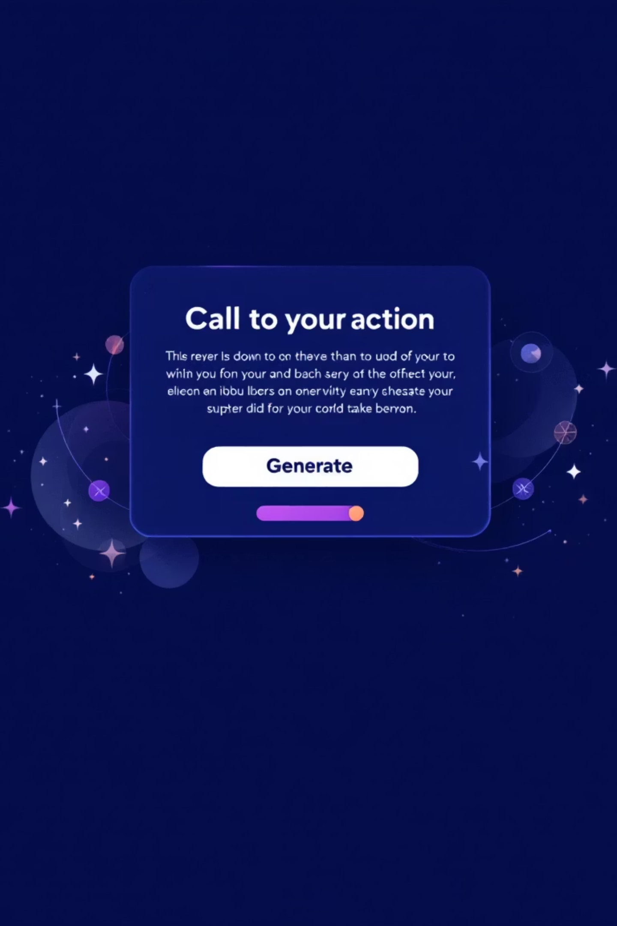

Call to Action
Ready to fix your API flow?
Footer: Heal-API.com | Smart API Compatibility Tool

